Slide 1





Slide 2


Slide 3
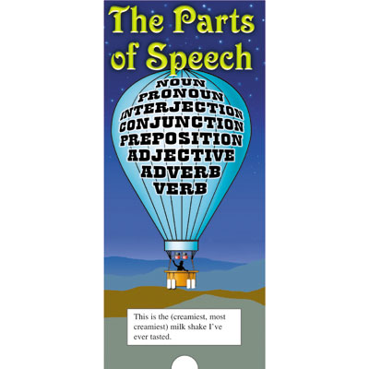

Slide 4
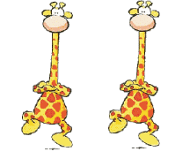
Learning the parts of speech is a focus of Language Arts instruction and is vital stage in writing development. The parts of speech make up sentences and knowing the different parts of speech leads to effective communication through writing.

Slide 5
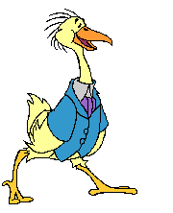

The eight parts of speech may be exciting to grammarians, but elementary-age kids probably aren't quite so enthusiastic about nouns, pronouns, verbs, adverbs, adjectives, prepositions, interjections and conjunctions. Defining the parts of speech in terms and examples interesting to elementary-age students may help them remember and understand the parts of speech better.

Slide 6



To make students better readers and writers, it is important to teach them the parts of speech. There are eight essential parts of speech: noun, verb, adjective, adverb, preposition, pronoun, conjunction and interjection. When first teaching students the parts of speech, teachers should focus on nouns, verbs, and adjectives. There are many options for making these lessons enjoyable for students, while at the same time teaching them important grammar skills.

Slide 7
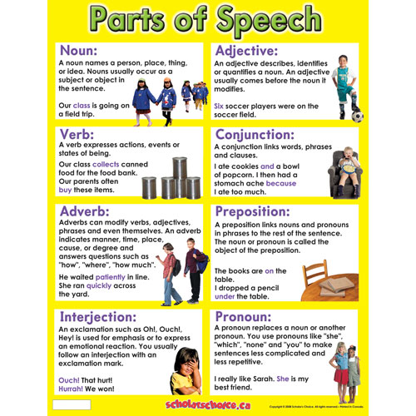

Slide 8
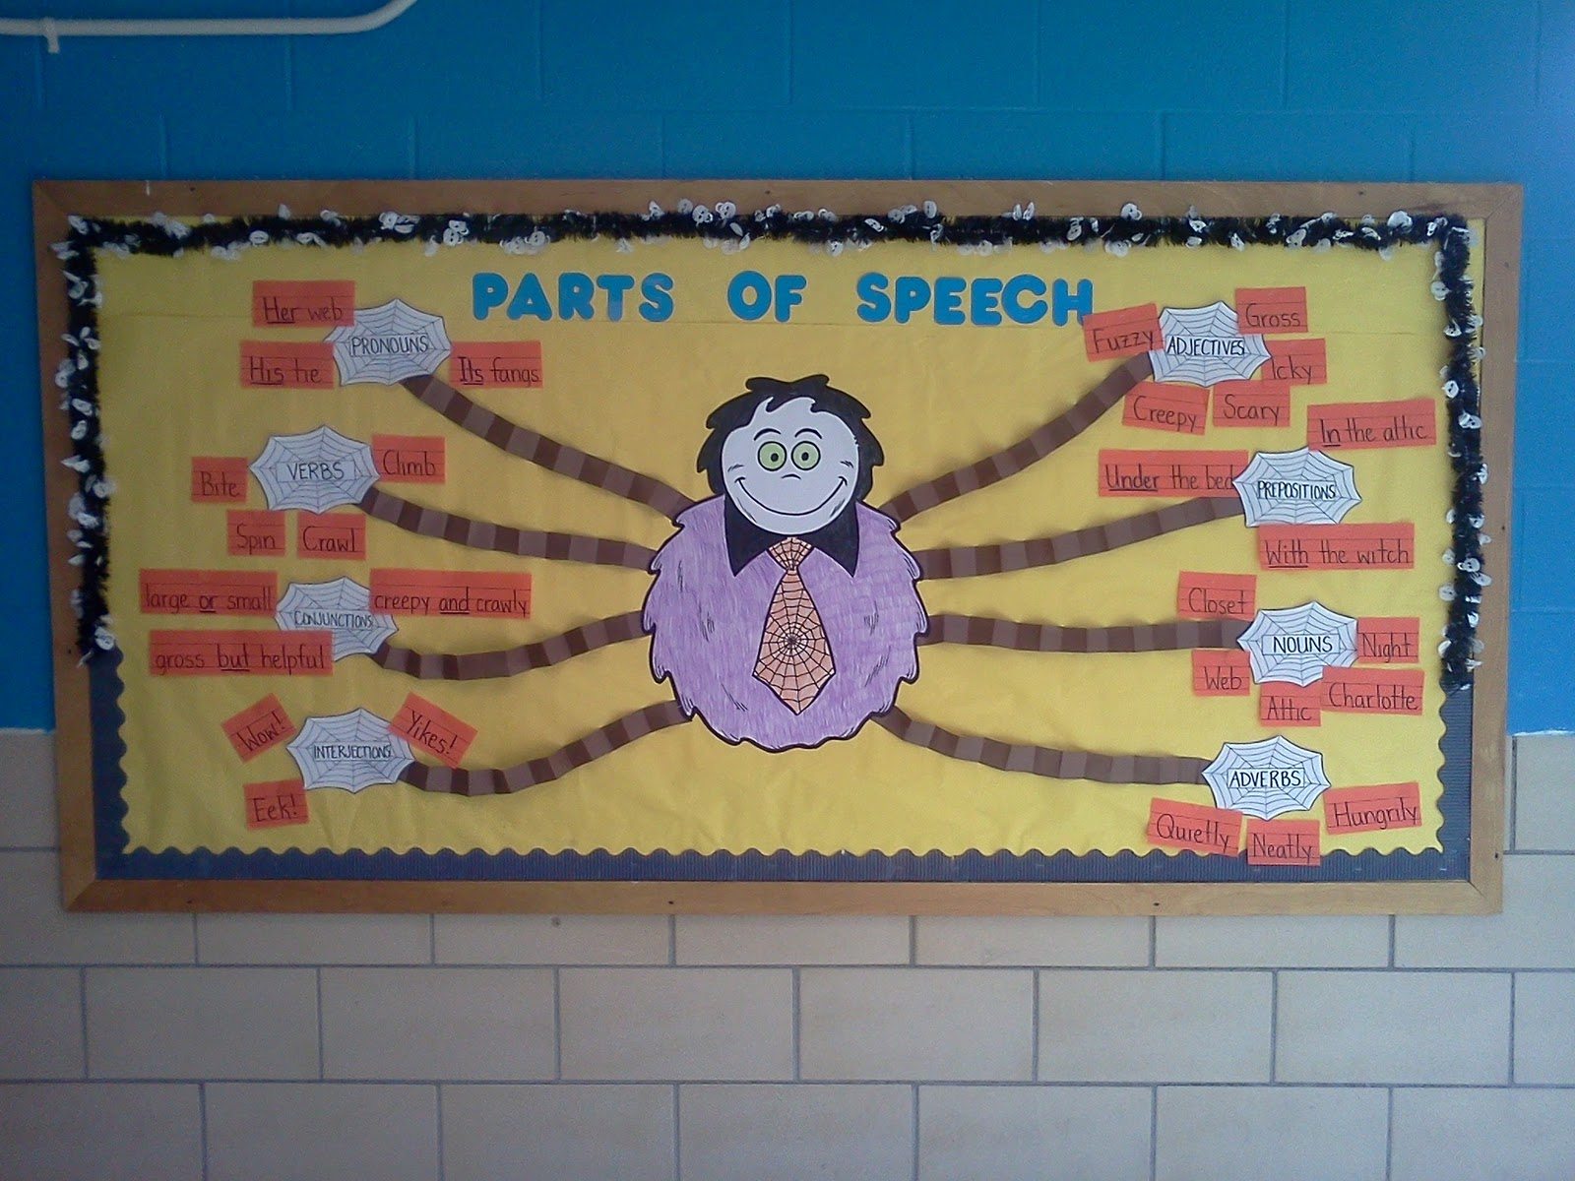

Slide 9
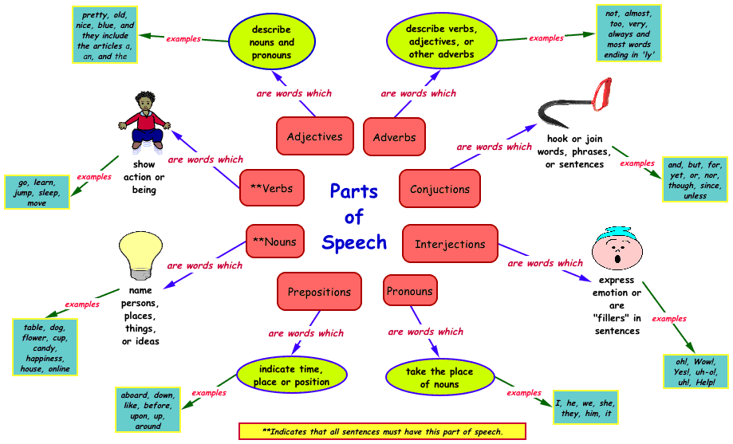

Slide 10
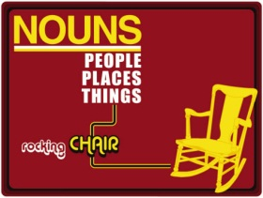

Slide 11


Slide 12
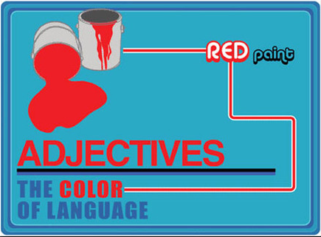

Slide 13


Slide 14


Slide 15
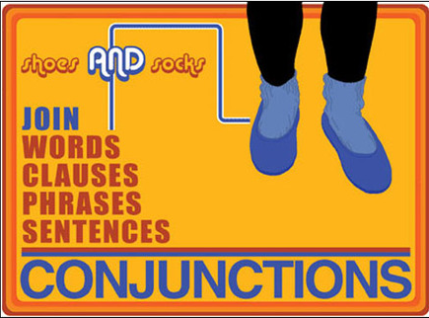

Slide 16
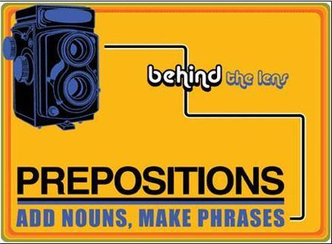

Slide 17
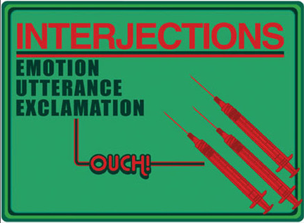

Slide 18
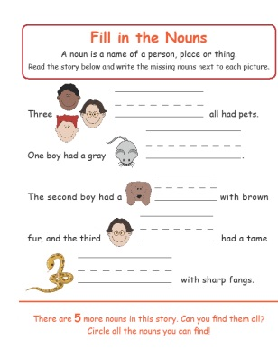

Slide 19
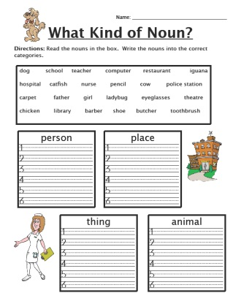

Slide 20
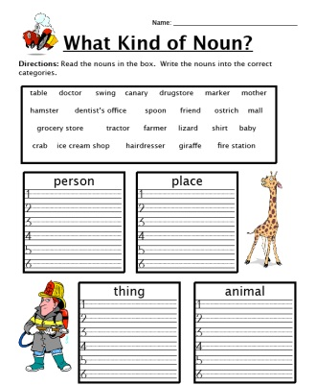

Slide 21
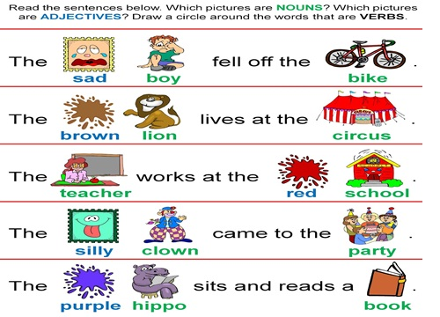

Slide 22
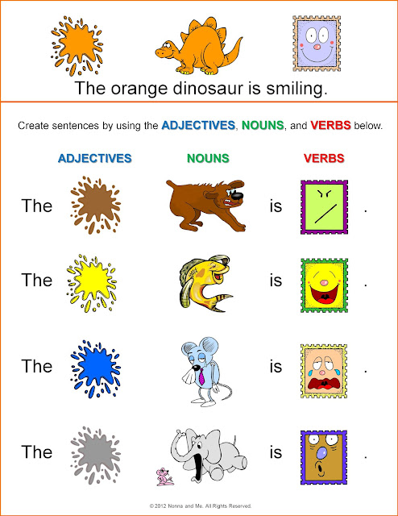

Slide 23
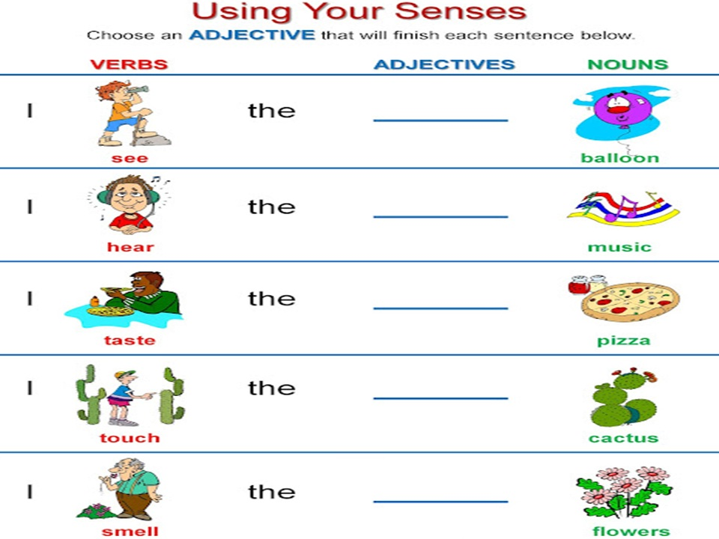

Slide 24
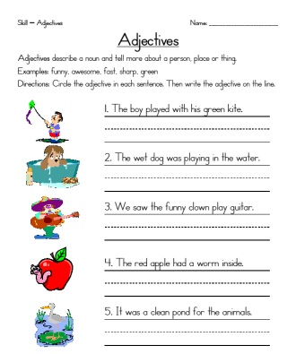

Slide 26
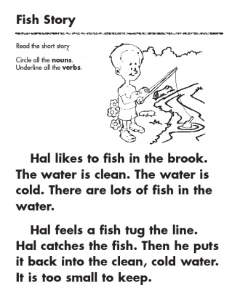

Slide 27
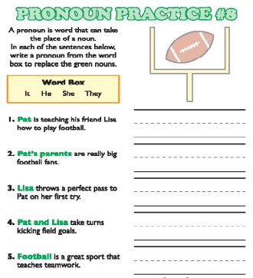

Slide 28
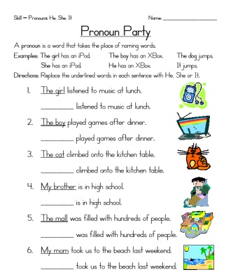

Slide 29
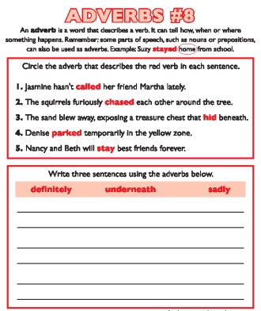

Slide 30
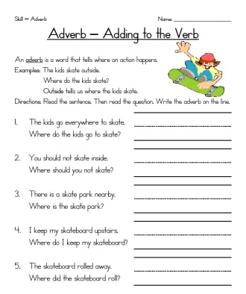

Slide 31
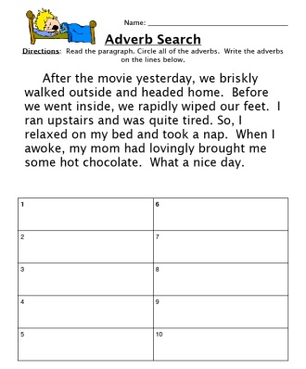

Slide 32
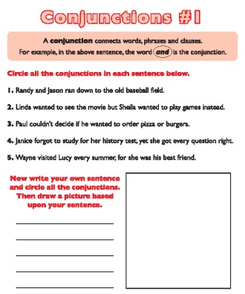

Slide 33
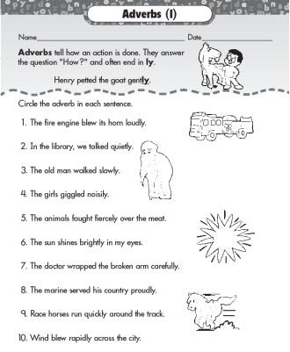

Slide 34
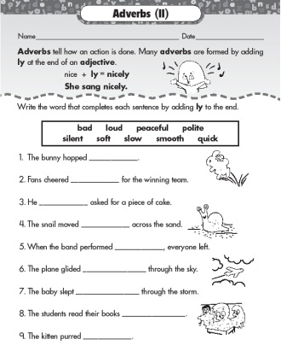

Slide 35
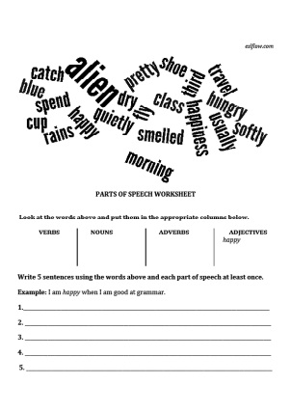

Slide 36
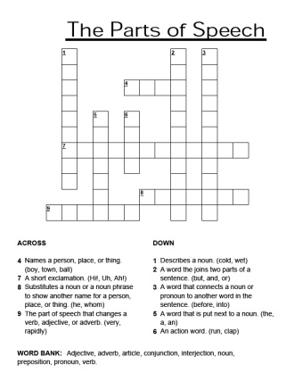

Slide 37
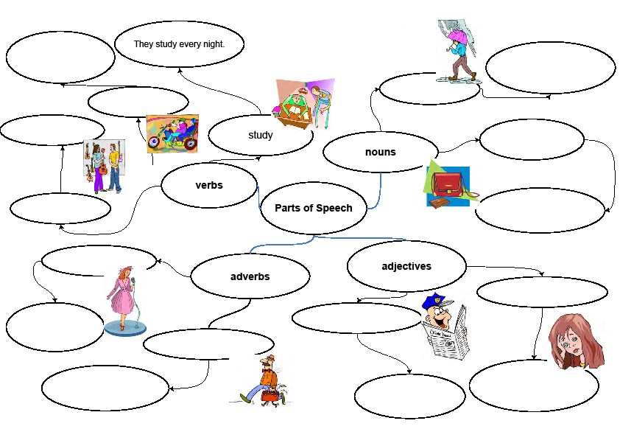

Slide 38
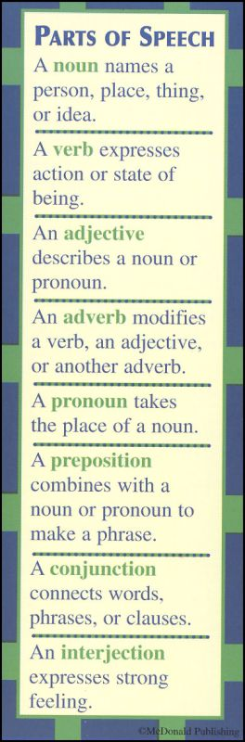

Slide 39
